Slide 1
Components

Slide 2
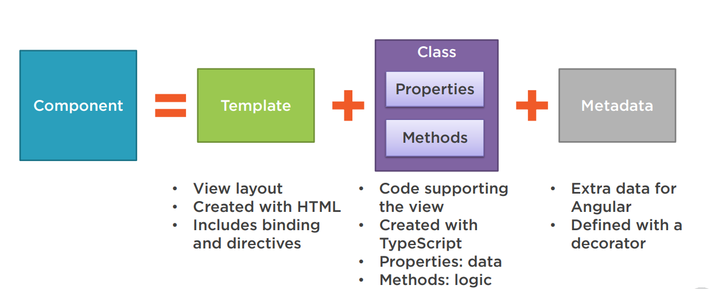
What is Component
The core idea behind Angular is to build components.
They make your complex application into reusable parts which you can reuse very easily.

Slide 3
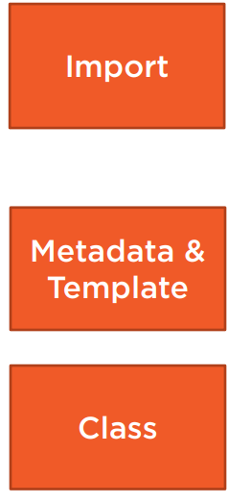
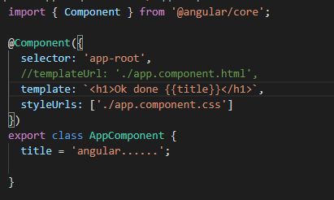
Code

Slide 4
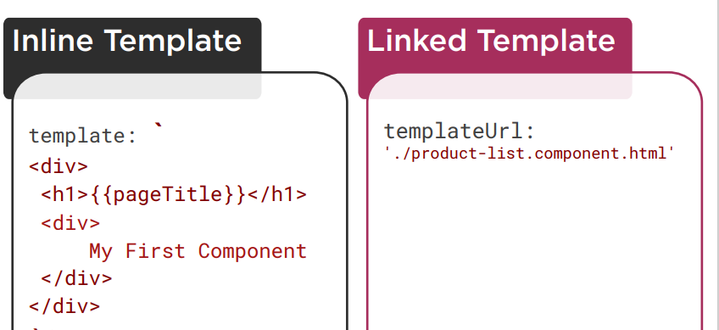
Decorator
A function that adds metadata to a class, its members, or its method arguments.
Prefixed with an @. Angular provides built-in decorators. @Component()

Slide 5
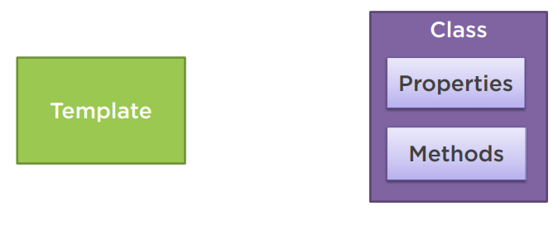
Binding
Coordinates communication between the component's class and its template and often involves passing data.

Slide 6
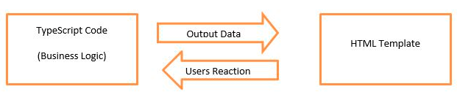
There is two type of databinding:
One-way databinding
One way databinding is a simple one way communication where HTML template is changed when we make changes in TypeScript code.
Two-way databinding
In two-way databinding, automatic synchronization of data happens between the Model and the View.
change is reflected in both components. Whenever you make changes in the Model, it will be reflected in the View and when you make changes in View, it will be reflected in Model.

Slide 7
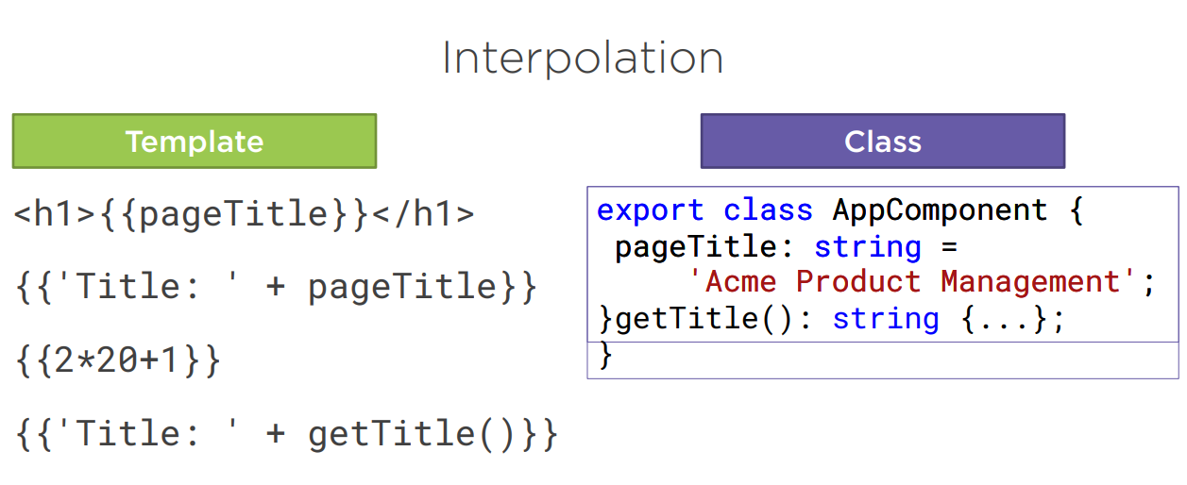
Interpolation
It facilitates you to make changes on component.ts file and fetch data from there to HTML template (component.html file).

Slide 8
Property Binding
Property binding flows a value in one direction, from a component's property into a target element property.
import { Component } from '@angular/core';
@Component({
selector: 'my-app',
template: `<div>
<button [disabled]='isDisabled'>Disable Me</button>
</div>`
})
export class AppComponent {
isDisabled: boolean = true/false;
}

Slide 9
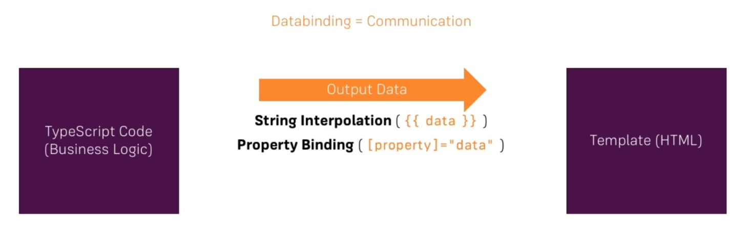

Slide 10

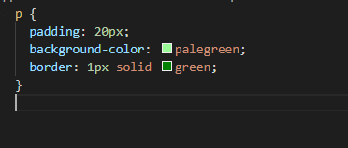
Exercises
Create two new Components (manually or with CLI): WarningAlert and SuccessAlert
Style the Components appropriately (maybe some red/ green text?)

Slide 11
Event Binding
In an event binding, Angular sets up an event handler for the target event. When the event is raised, the handler executes the template statement.
<button class="btn btn-primary"
[disabled]="!allowNewServer"
(click)=“displayAlert()">Add Server</button>
Ts file
displaAlert(){
Alert(“Ok done”);
}

Slide 12
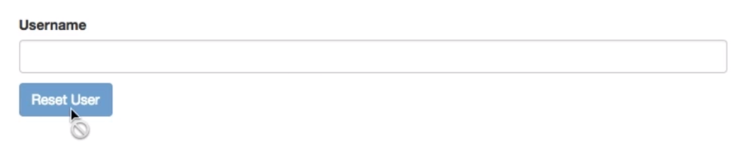
W.a.p to display this action

